Slide 1
Java Arrays:what is the index concept in an array? How to create and initialize an array? Types of arrays with examples?
-Pranali Chougule

Slide 2
Array
An array is a data structure that stores a collection of elements of the same data type in a contiguous memory location. In Java, an array allows you to store multiple values in a single variable, making it easier to manage and access a large amount of data with similar attributes.
Key Characteristics of Arrays
Fixed Size:Once an array is created, its size cannot be changed. If you need a different size, you must create a new array.
Same Data Type:All elements in an array must be of the same data type (e.g., all integers, all strings).
Indexed Access:Each element is accessed by its index (position), starting from 0 and going up to array.length – 1
Contiguous Memory Allocation:Elements in an array are stored in consecutive memory locations, which allows fast access using indexes.

Slide 3
Index concept in an array
The index in an array is the position number assigned to each element, allowing you to access and manipulate specific elements directly.
In Java, arrays use zero-based indexing, which means:
The first element is at index 0.
The second element is at index 1.
The third element is at index 2, and so on.
For example, in the array int[] numbers = {10, 20, 30, 40};
numbers[0] accesses the first element (value 10).
numbers[1] accesses the second element (value 20).
numbers[2] accesses the third element (value 30).

Slide 4
Why Indexing is Important
Efficient Access:
Indexing allows direct access to any element in constant time O(1), which is fast and efficient.
Element Manipulation:
It enables you to update or retrieve specific elements without traversing the whole array.

Slide 5
Creating and Initializing an Array
Creating and initializing an array in Java can be done in a few different ways:
1. Declaration and Instantiation
First, declare an array variable with a specified data type and then instantiate it with a fixed size.
The size of an array is fixed after creation.
2. Declaration, Instantiation, and Initialization in One Step
You can also declare, instantiate, and initialize an array in a single line if you know the elements in advance.
int[] numbers = new int[5]; // Creates an array of integers with 5 elements, initialized to 0 by default
int[] numbers = {10, 20, 30, 40, 50}; // Creates and initializes an array with values 10, 20, 30, 40, 50

Slide 6
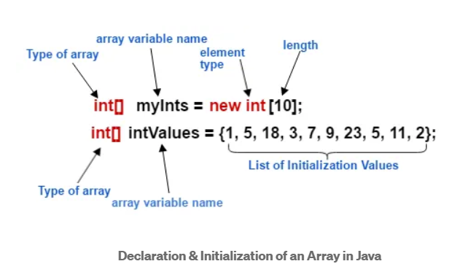
3. Array Initialization After Declaration
You can declare an array variable first, then instantiate and initialize it later.
int[] numbers; // Declaration
numbers = new int[]{5, 15, 25, 35, 45}; // Instantiation and Initialization

Slide 7
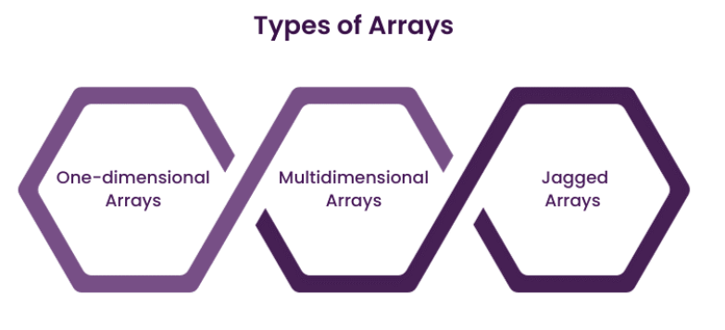

Slide 8
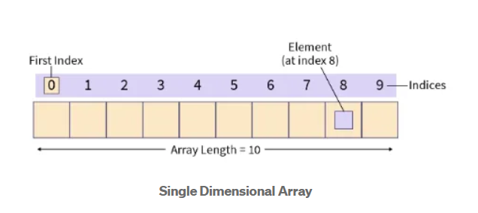
Single-Dimensional Array
A single-dimensional array stores elements in a single row or list.
It is the simplest form of an array where each element can be accessed with a single index
int[] singleArray = {10, 20, 30, 40, 50}; // Creates an array of integers with 5 elements
System.out.println(singleArray[2]); // Accessing the third element (index 2) - Output: 30

Slide 9
Multi-Dimensional Array
A multi-dimensional array is an array of arrays, where each element can itself be an array.
The most common form of multi-dimensional array in Java is a two-dimensional array, which can represent a table with rows and columns.
Higher-dimensional arrays (3D, 4D, etc.) are also possible, although less common.
int[][] multiArray = {
{1, 2, 3},
{4, 5, 6},
{7, 8, 9}
};
System.out.println(multiArray[1][2]); // Accessing element in the second row, third column - Output: 6

Slide 10
Jagged Array
In Java, a jagged array is a type of multi-dimensional array where the inner arrays have different lengths.
Unlike a standard 2D array, where all rows have the same length, each row in a jagged array can have a different number of elements.
This type of array can be useful when working with data that varies in size per row.
int[][] jaggedArray = new int[3][];
jaggedArray[0] = new int[]{1, 2}; // First row has 2 elements
jaggedArray[1] = new int[]{3, 4, 5}; // Second row has 3 elements
jaggedArray[2] = new int[]{6, 7, 8, 9}; // Third row has 4 elements
System.out.println(jaggedArray[2][3]); // Accessing element in the third row, fourth column - Output: 9

Slide 11
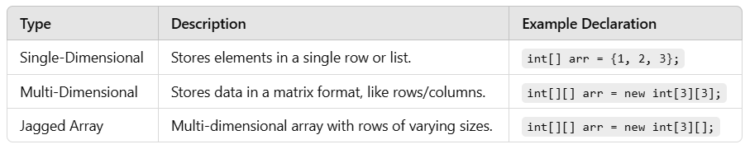

Slide 12
public class ArrayExample {
public static void main(String[] args) {
int[] singleArray = {10, 20, 30, 40, 50};
System.out.println("Single Array Element: " + singleArray[2]);
int[][] multiArray = {
{1, 2, 3},
{4, 5, 6},
{7, 8, 9}
};
System.out.println("Multi Array Element: " + multiArray[1][2]);
int[][] jaggedArray = {
{1, 2},
{3, 4, 5},
{6, 7, 8, 9}
};
System.out.println("Jagged Array Element: " + jaggedArray[2][3]);
}
}

